Slide 1
Recycling Electronics
Rob Donohue

Slide 2

Purpose Statement
To let the audience know the amounts of e-waste that are produced by use and how we can cut back on this dramatically by recycling our electronics

Slide 3
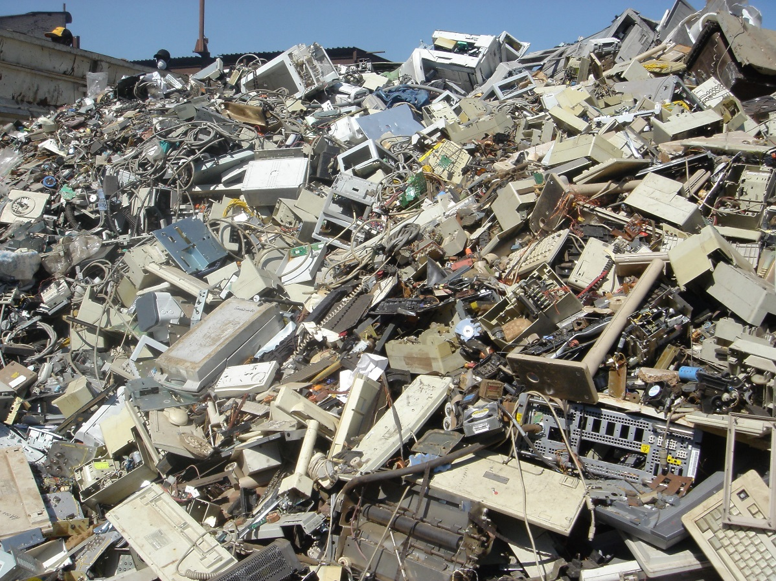
Background info
40 million tons of e-waste each year
3.2 million tons in the US
80% of e-waste is not recycled
Many materials used are toxic when burned
(Green Leigh, Choi, & Hoelzel, 2012)

Slide 4
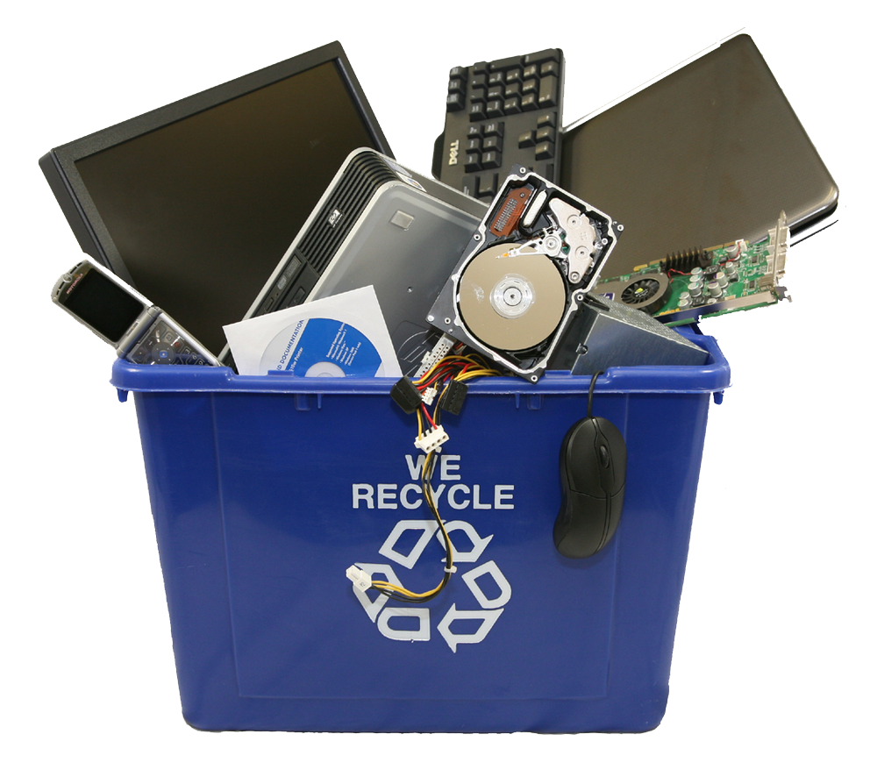
Places to recycle electronics
Best Buy
Staples
Dell
Mobile Carriers
Office Depot / OfficeMax
Local Recycling Centers
(Griffith, 2016)

Slide 5

Why people don’t recycling electronics:
Don’t know where to recycle them
It’s too hard
It’s not a big deal
Not worth their time

Slide 6
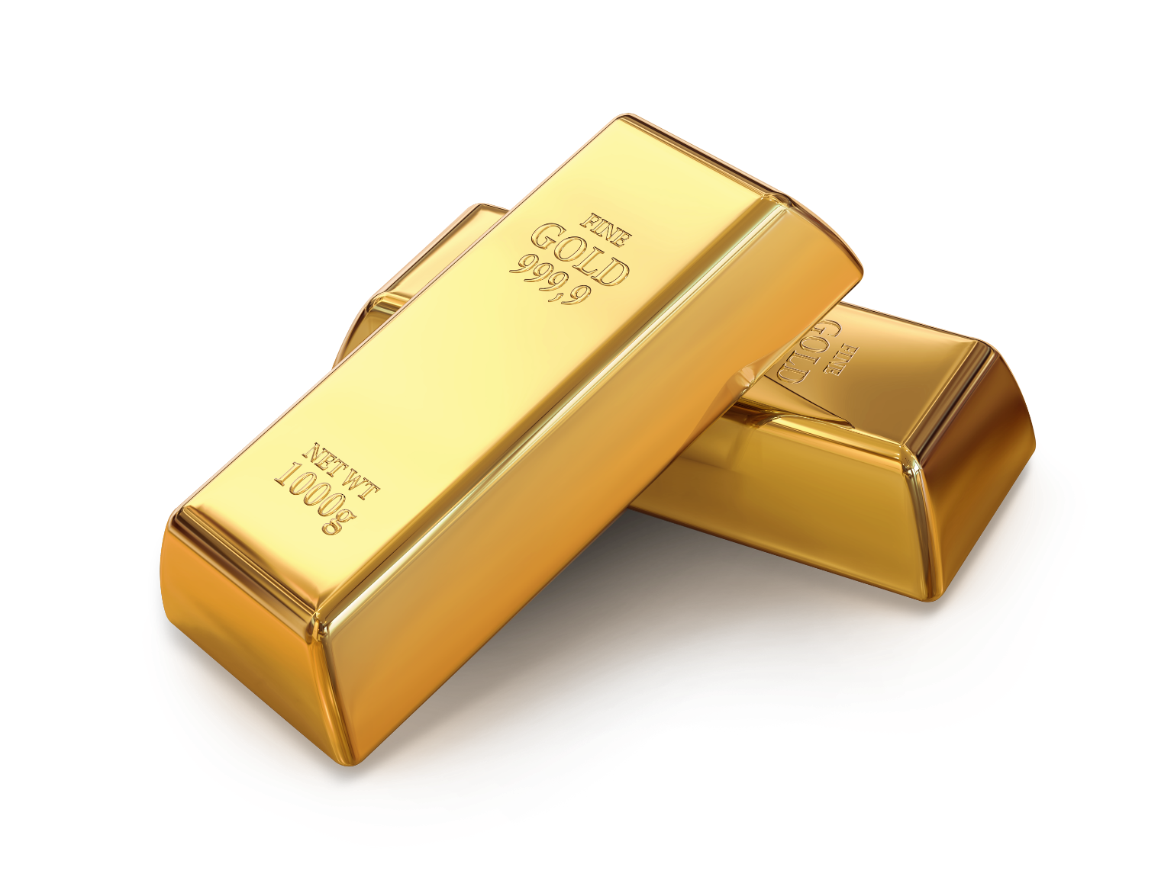
Benefits of electronics recycling
Conserves natural resources
Avoids air & water pollution
One million laptops = electricity for 3,500 US homes
One millon cell phones = 35k lbs of copper, 772 lbs of silver, 75 pounds of gold, 33 lbs of palladium
(United States Environmental Protection Agency, 2016)

Slide 7
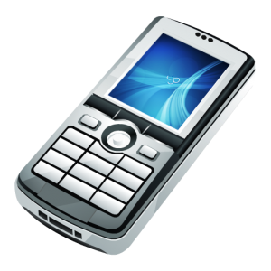
What you can do to help
Donate old usable electronics
Support local recycling centers
Trade-in old electronics when upgrading
Think before tossing old electronics in the garbage

Slide 8
Works Cited
Green Leigh, N., Choi, T., & Hoelzel, N. Z. (2012). New Insights into Electronic Waste Recycling in Metropolitan Areas. Journal of Industrial Ecology, 940-950.
Griffith, E. (2016, April). How to Recyle Your Technology. PC Magazine, pp. 120-125. Retrieved from PC Magazine.
United States Environmental Protection Agency. (2016, April 7). Electronics Donation and Recyling. Retrieved from United States Environmental Protection Agency: https://www.epa.gov/recycle/electronics-donation-and-recycling#why

